Slide 1
CONTINUOUS INTEGRATION & CONTINUOUS DEPLOYMENT

Slide 2
PROBLEM STATEMENT
59. Simple HTML Website with CI/CD Pipeline
Scenario
A static website needs automated deployment whenever code changes.
Objective
Create CI/CD pipeline for HTML website.
Requirements
● Host code in GitHub.
● Configure Jenkins pipeline.
● Deploy the website automatically.
Deliverables
● GitHub repository
● Jenkins pipeline.

Slide 3
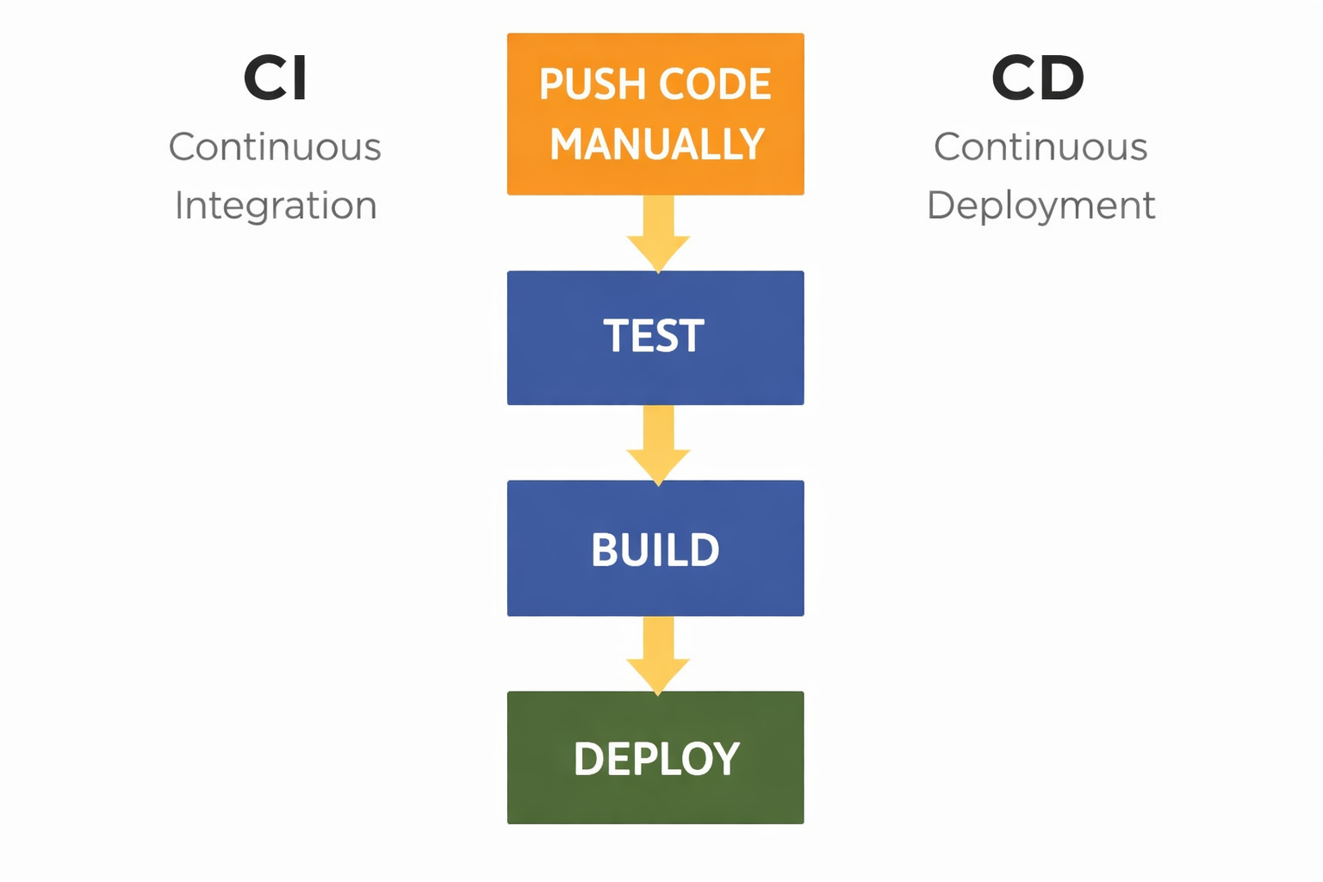
FLOW DIAGRAM

Slide 4
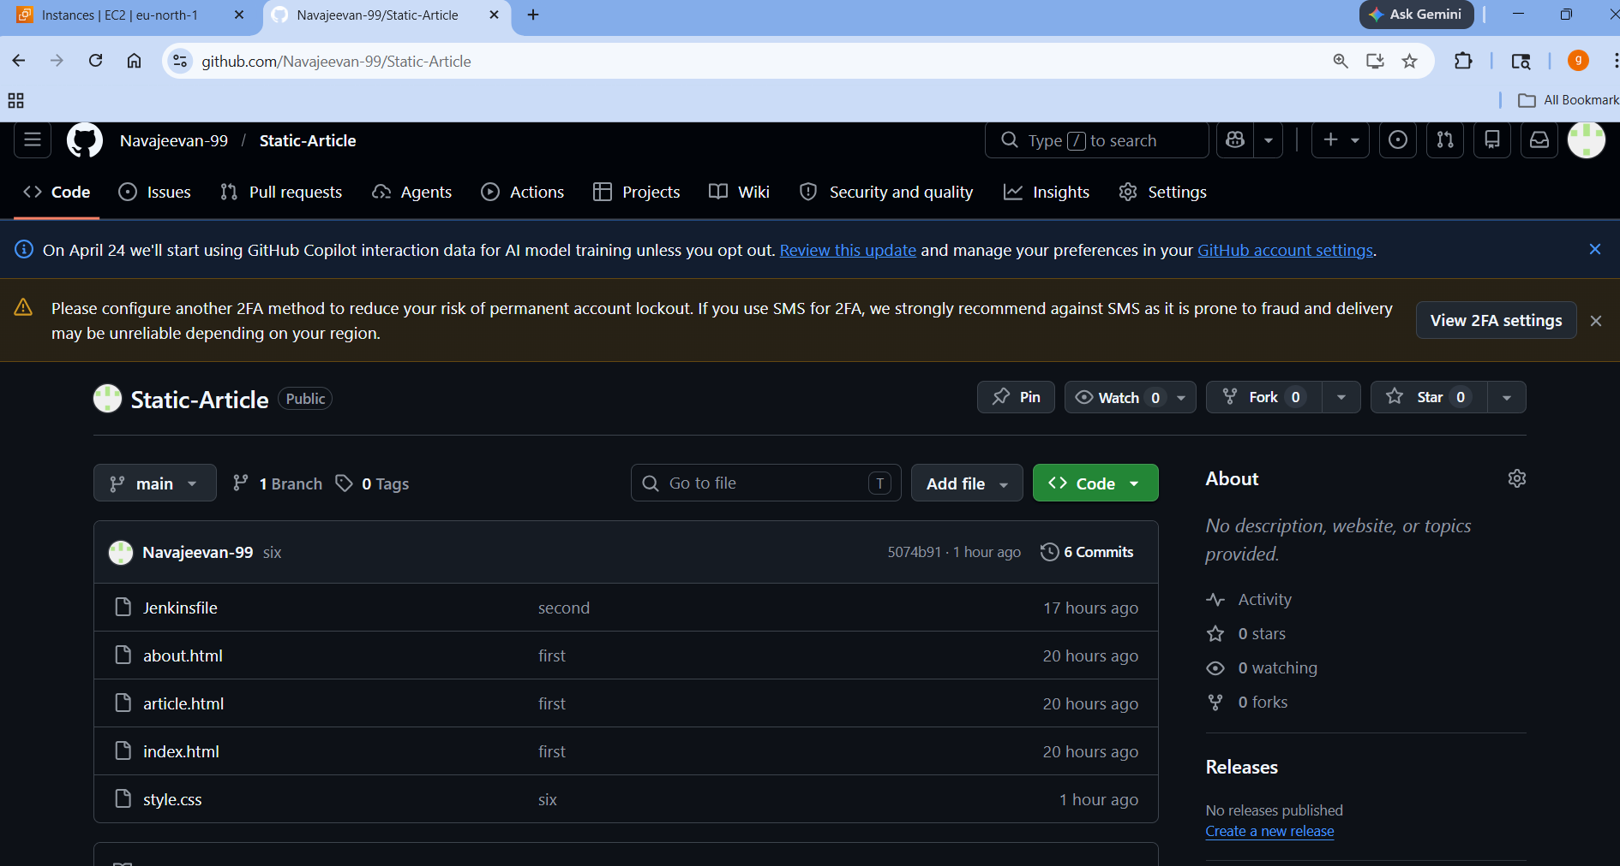
PICTURES OF EACH STAGES
1) PUSH THE CODE TO GITHUB

Slide 5
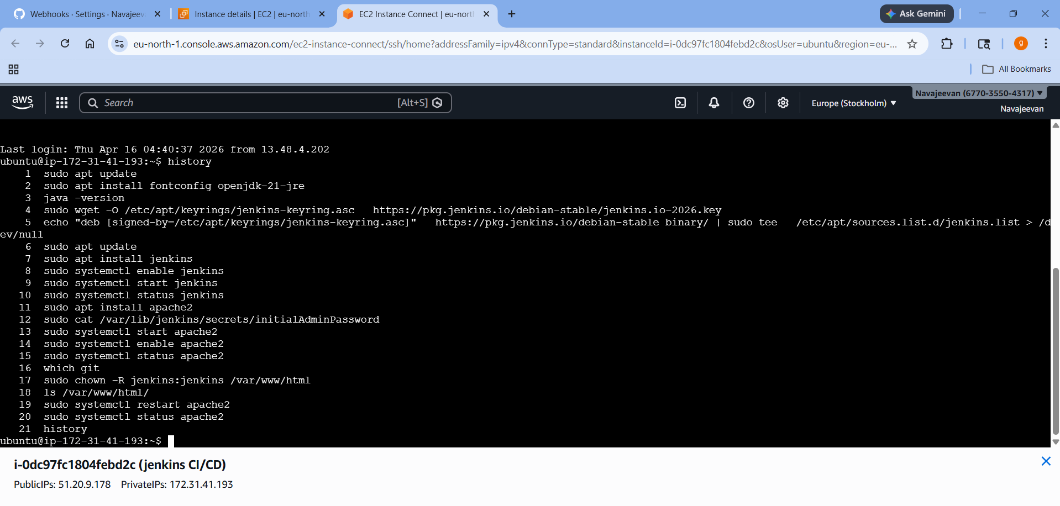
2) INSTALLATION OF JENKINS AND APACHE SERVER

Slide 6
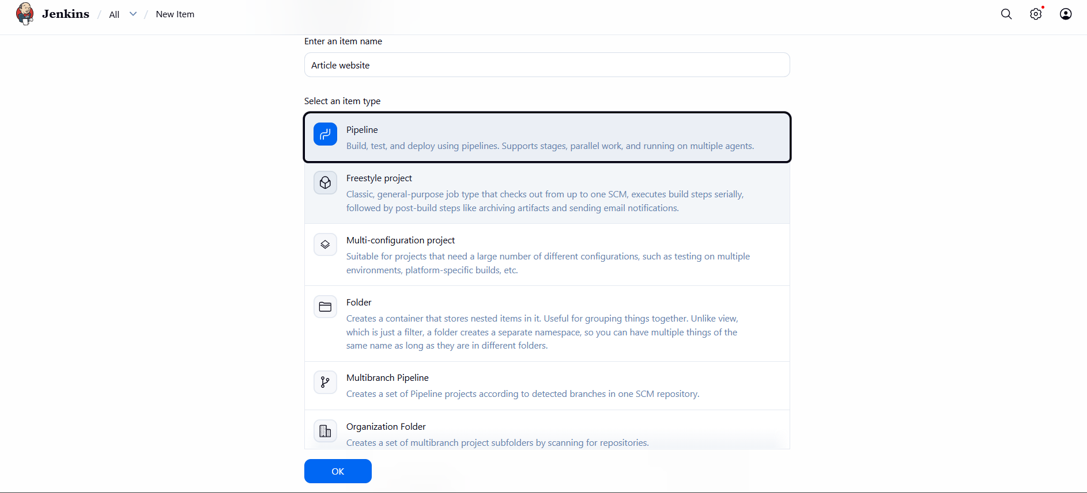
3) PIPELINE CREATION

Slide 7
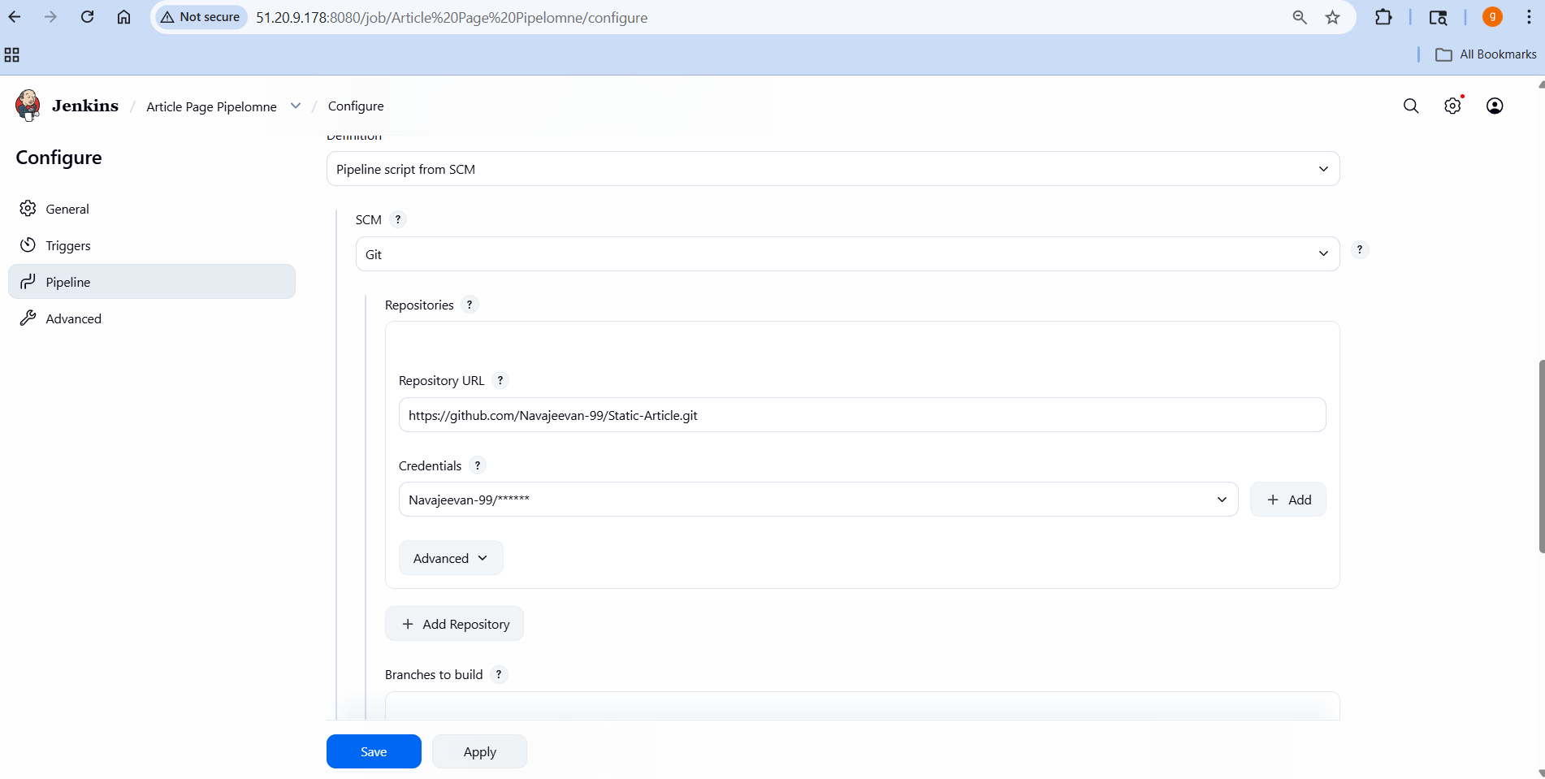
4) PIPELINE CONFIGURATION FOR PIPELINE SCRIPT

Slide 8
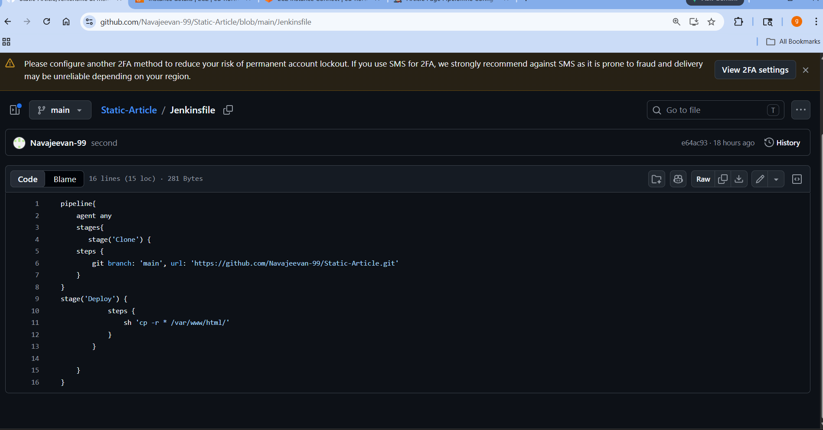
5) PIPELINE SCRIPT

Slide 9
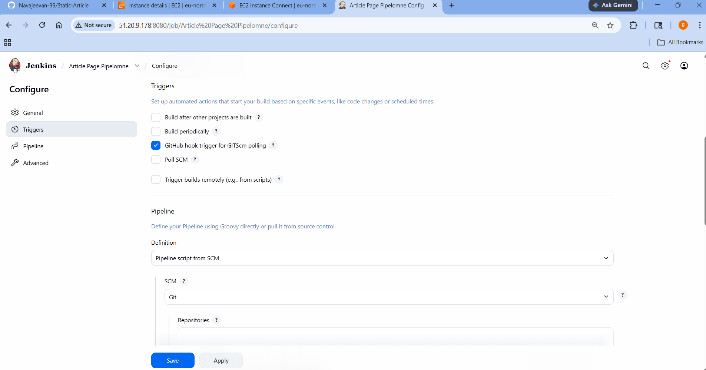
5) CONFIGURATION FOR AUTOMATIC CLONE FROM REPOSITORY

Slide 10
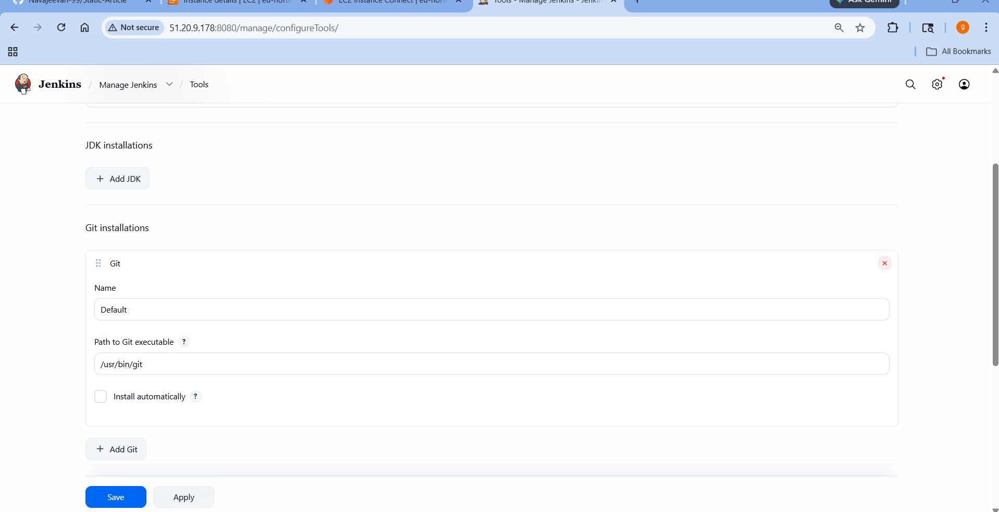
6) JENKINS NEED GITHUB PATH

Slide 11
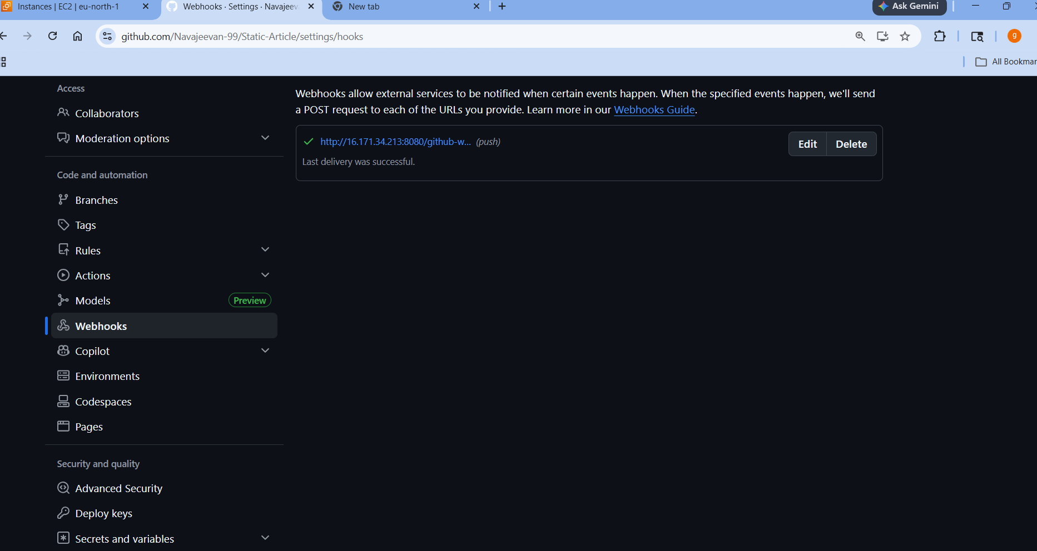
7) CONNECTING GITHUB AND JENKIN USING WEBHOOK

